Slide 1
Goodbye, evil autism
The Distinct Autistic People

Slide 2
The Target of Application
The App is target 3 types of people with 3 sections:
1) The autistic person.
2) The Family of the autistic person.
3) People in General.

Slide 3
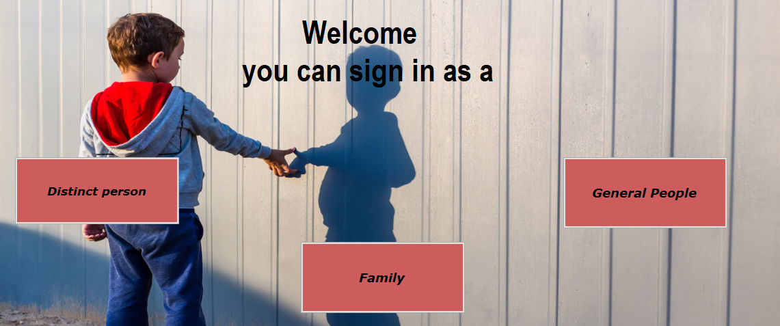

Slide 4
The Distinct Autistic People Department
In this Department there are many sections:
1) Achievements board.
2) Road Map for overcoming autism.
3) How to deal with bullying and people in general.
4) Contact information for specialist doctors and book treatment sessions.
5) online chat with doctors for free.
6) online group chat with the autistic people.

Slide 5
The Autistic Person Department
7) chat one to one to chat with a person have not autism.
8) learn (technology, sports, art, poem).
9) Reading Books.
10) Articles.

Slide 6
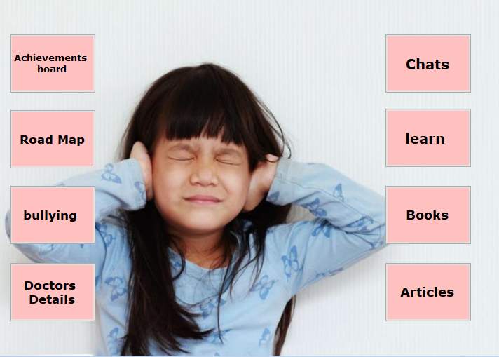

Slide 7
Achievements board Section
1) Achievements of children who have overcome autism.
2) Weekly achievement by Machine Learning,
to encourage children to continue .

Slide 8
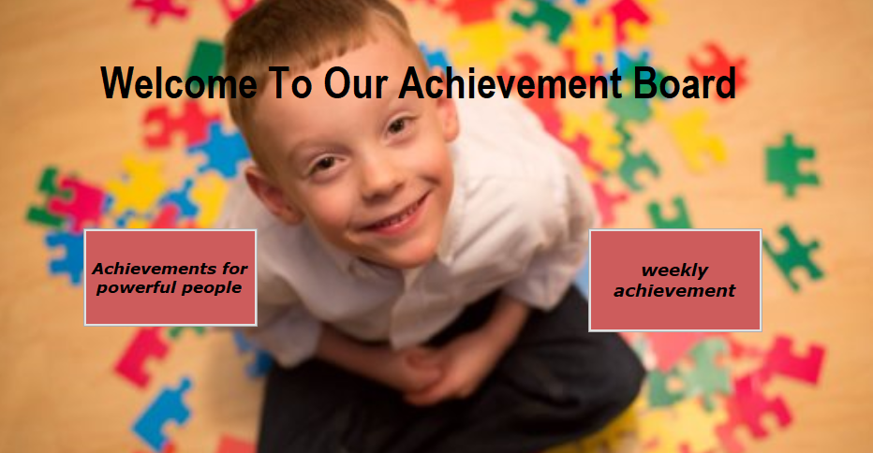

Slide 9
Road Map Section
1) Online courses and exam for each lesson.
If he cannot pass the exam, the new lesson will not be opened.
2) How to use other sections parallel with the road map and level of progress.
So that he doesn't enter a section higher than his level and get frustrated.

Slide 10
Articles Section
1) Motivational articles to encourage them to continue.
2) Articles to tell them that they are distinct and strong people.
3) Articles about the importance of dealing with other people, to encourage them not to give up.

Slide 11
Doctors Details Section
Contact information for specialist doctors.
-you can book a treatment session in our App.
treatment sessions maybe:
1- online in this App.
2- Doctor's clinic.

Slide 12
Chat Sections
1) Chat with doctors for free.
2) Group Chat.
3) then we enter it to communicate gradually by way of:
A) At first with autism.
B) then Communicate with others:
a) First in the chat.
b) Then a webcam.
c) Then face to face.

Slide 13
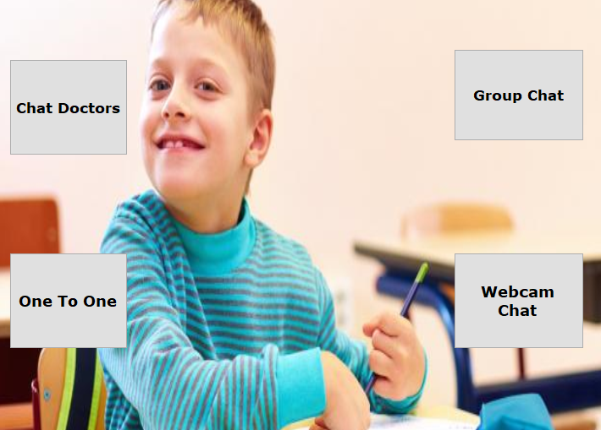

Slide 14
learn Section
During the treatment period, the child will learn some things to benefit him,
to have fun, and not give up.
1) technology.
2) maths.
3) sports.
4) art.
5) poem.

Slide 15
Dealing with people Section
Advise on how to deal with people in General.
How to deal with bullying and to make it don't affect his psyche.

Slide 16
The Family Department
we will teach them how to deal with their autistic children in the right way, to overcome autism and encourage them.

Slide 17
General people Department
1) how to deal with autistic people in the right way.
2) section for donations.
3) Also
With the spread of technology and smart mobile phones, everyone is vulnerable to autism, so we teach people
how to protect themselves and their children from autism.

Slide 18
Thank you!

